Slide 1
Classification
CS3300 Data Science
RJ Nowling

Slide 2
Readings
Sections 9.6-9.7, 7.4.1-7.4.3

Slide 3
Common Forms of Machine Learning
Supervised Learning
Regression – predicting a continuous output
Classification – predicting a categorical output
Unsupervised Learning
Clustering – grouping similar records

Slide 4
Classification Problems
Is the animal in the picture a cat or a dog?
Is the customer likely to default on their credit card?
What character is in the image?

Slide 5

Iris Data Set
Trying to classify irises as one of three species
Response: species
Features (predictors) are:
Petal width
Petal height
Sepal width
Sepal height
https://www.americanmeadows.com/flower-bulbs/iris-flower-bulbs/dutch-iris-bulbs-sapphire-beauty

Slide 6
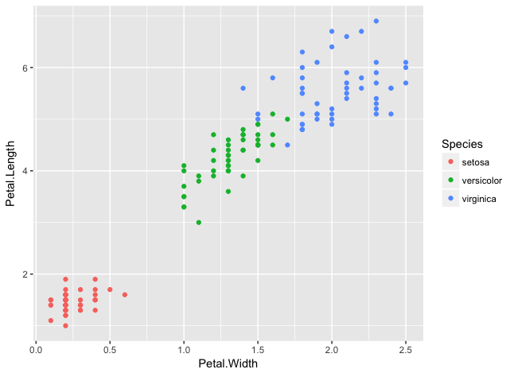
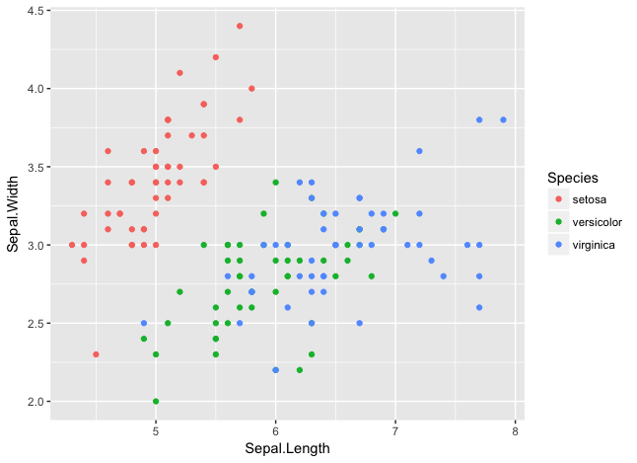
Iris Data Set

Slide 7
Iris Data Set

Slide 8
Logistic Regression
Despite its name, Logistic Regression is a method for classification, not regression
Part of a larger class of models called Generalized Linear Models
Linear Regression
Logistic Regression

Slide 9
Logistic Regression
Logistic Regression assumes that there are two outputs (e.g., positive and negative)
Logistic Regression actually outputs a probability that the data point is in the positive class: P(y = 1)
We threshold this probability. If P(y=1) >= 0.5, we predict y=1. Otherwise, we predict y=0.

Slide 10
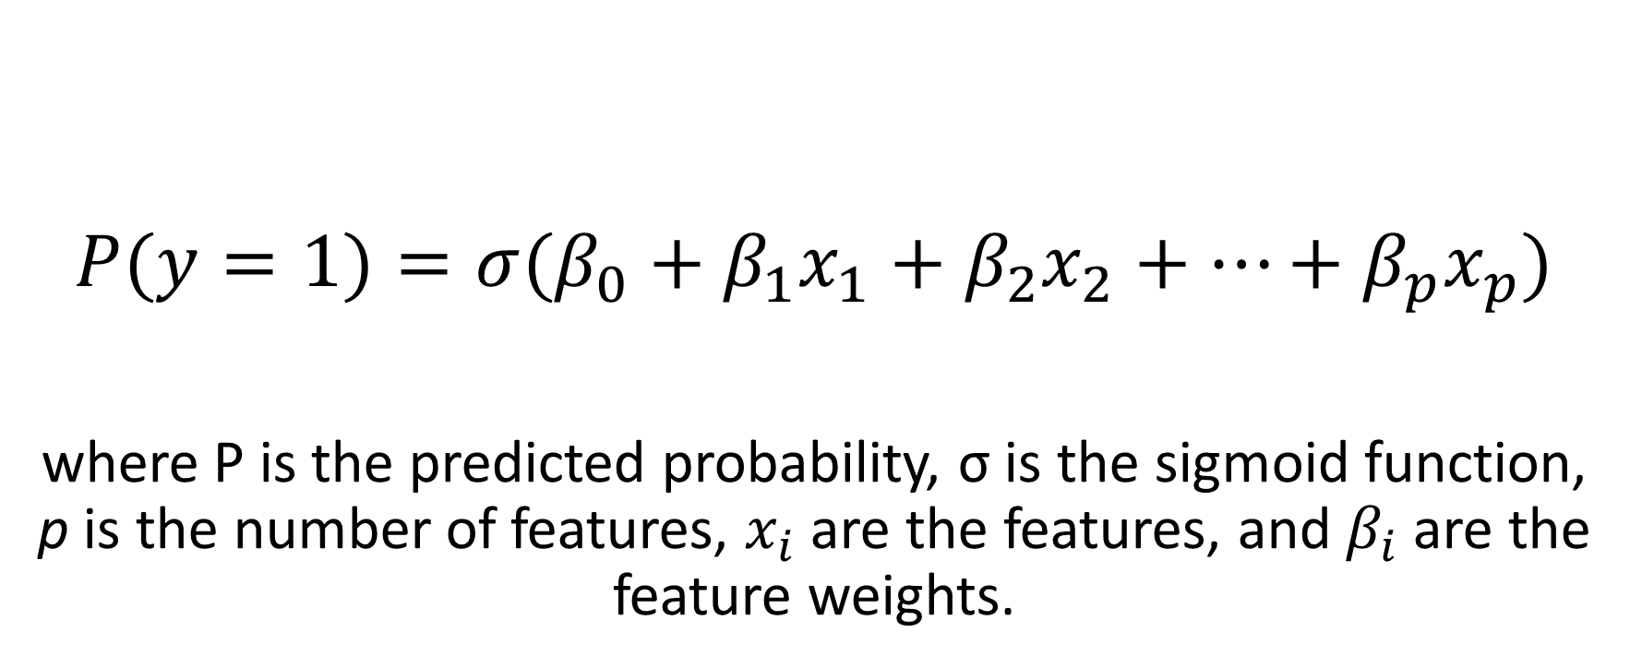
Logistic Regression
$$P(y=1)=σ(β_{0}+β_{1}x_{1}+β_{2}x_{2}+⋯+β_{p}x_{p})$$
where P is the predicted probability, σ is the sigmoid function, p is the number of features, $x_{i}$ are the features, and $β_{i}$ are the feature weights.

Slide 11
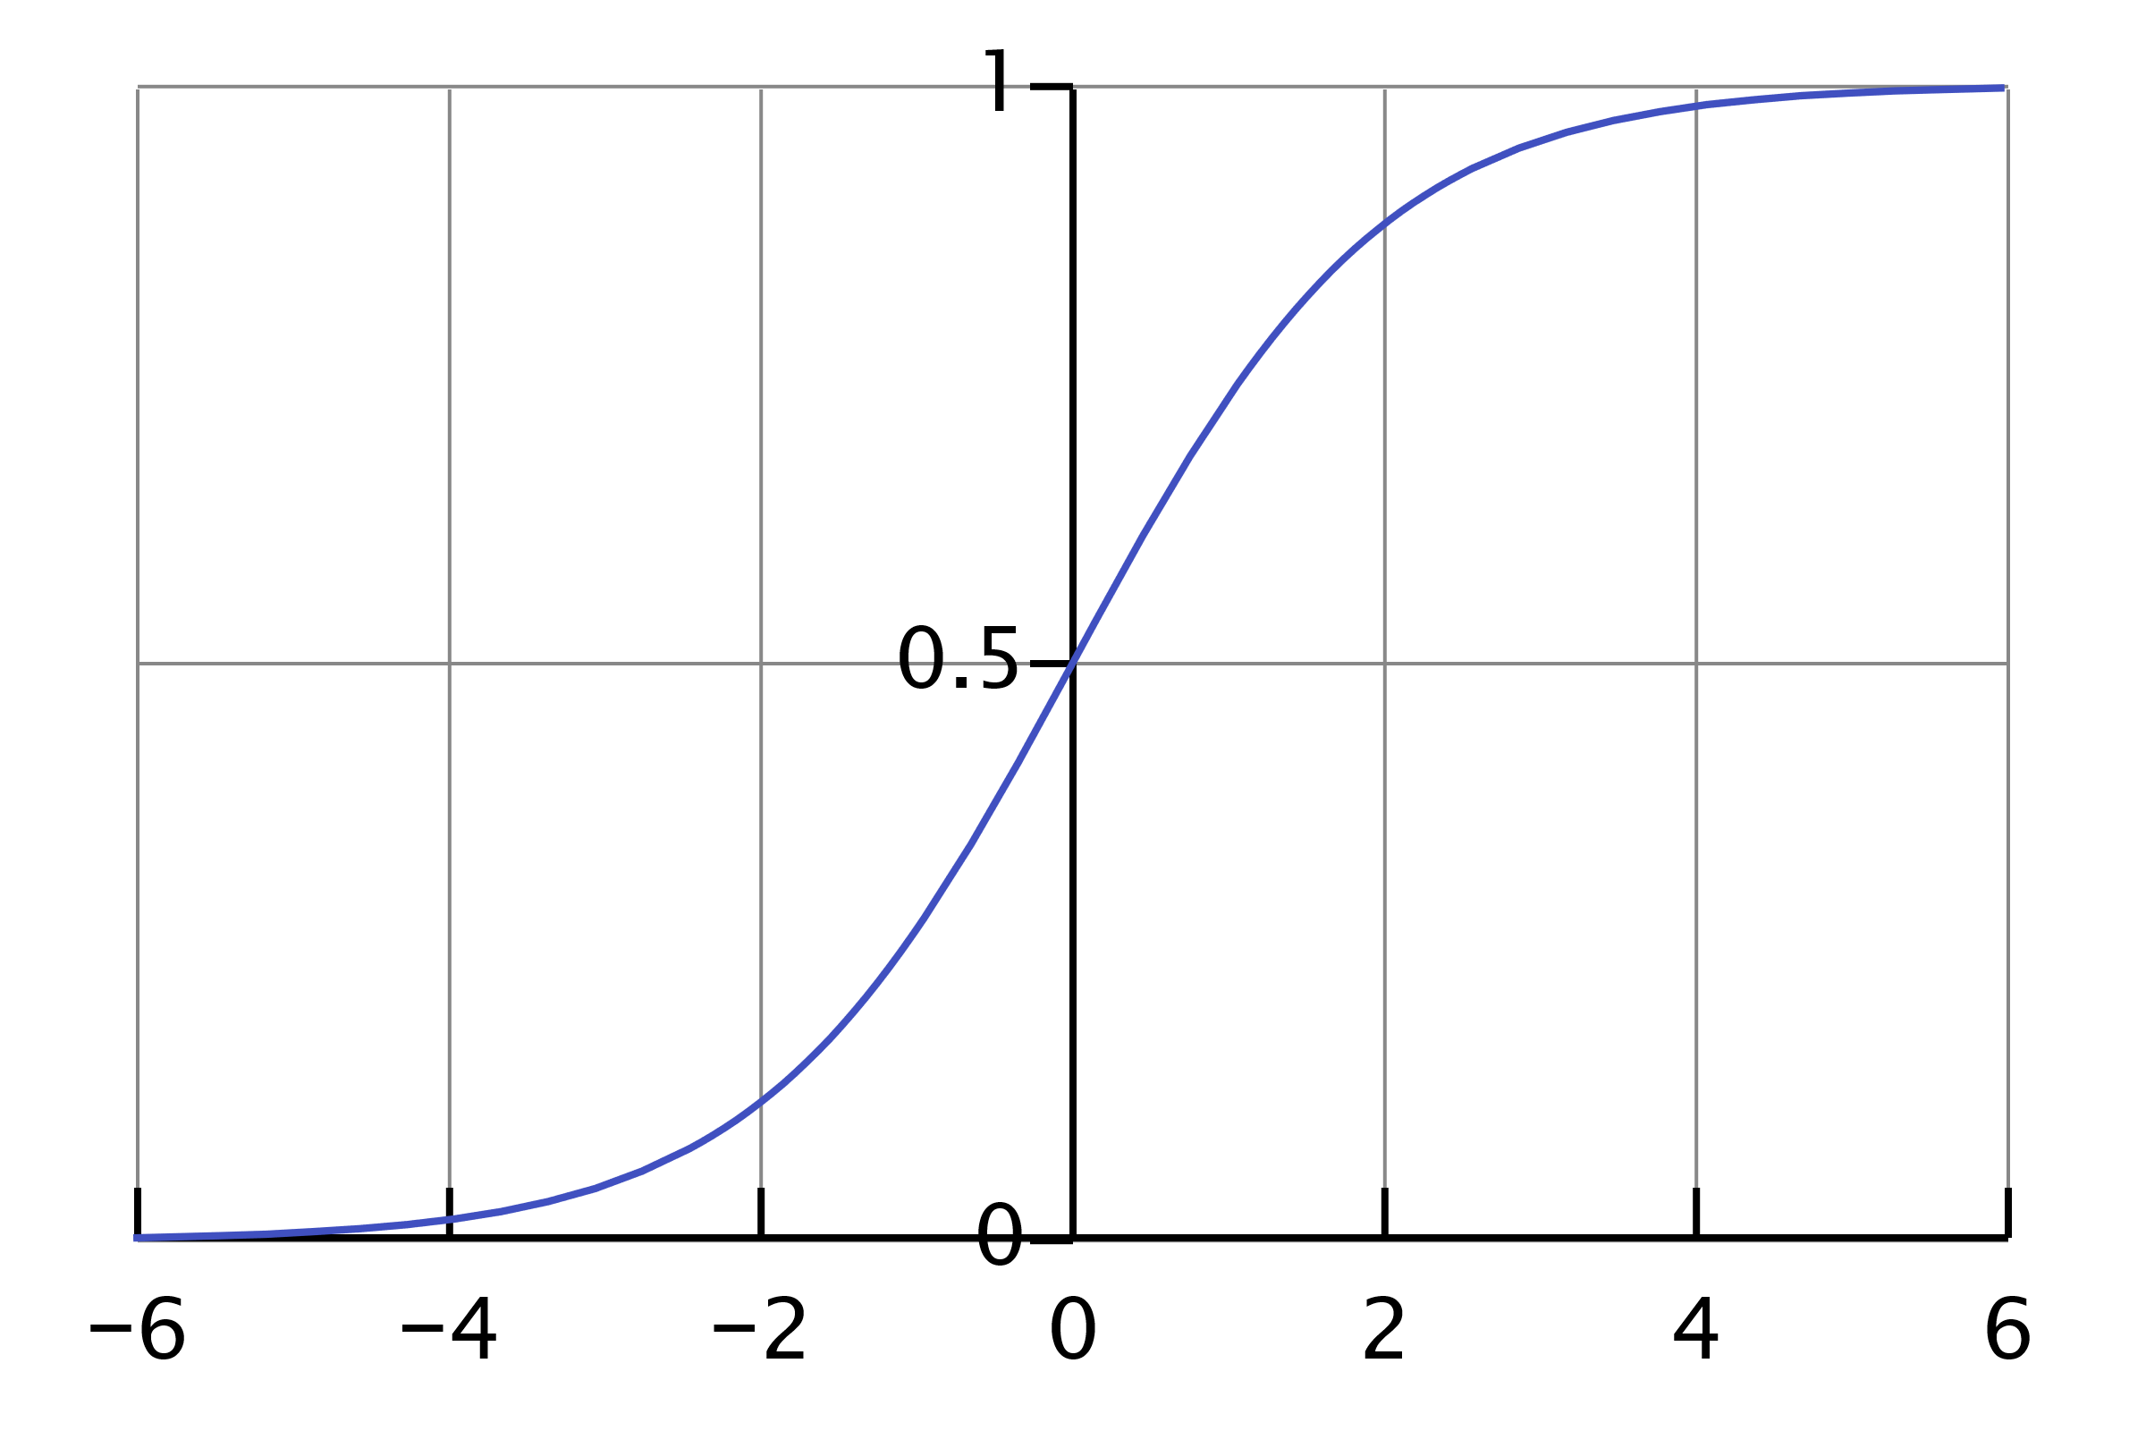
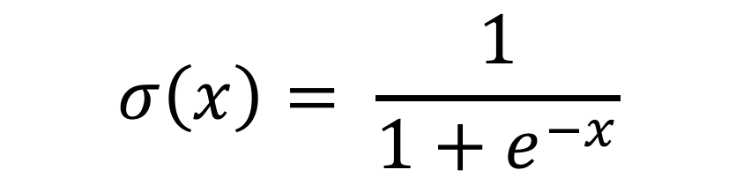
Sigmoid Function
$$σ\left(x\right)= \frac{1}{1+e^{−x}}$$

Slide 12
Likelihood Function
$$L\left(β_{0},β_{1},…,β_{p} | y,x_{1},x_{2},…,x_{p}\right)=\prod_{i=1}^{n}{{p(y_{i}=1)}^{y_{i}}{(1−p\left(y=1\right))}^{1−y_{i}}}$$

Slide 13
Logistic Regression in Scikit Learn
Scikit-Learn contains two main LR implementations:
LogisticRegresion
SGDClassifier
We will use SGDClassifier for the examples in this class

Slide 14
Fit LR Model
features = iris.data[:, 2:],
sgd = SGDClassifier(max_iter=1000, tol=1e-3, loss="log")
sgd.fit(features, setosa_labels)
pred_labels = sgd.predict(feature)
pred_prob = sgd.predict_proba(features)

Slide 15
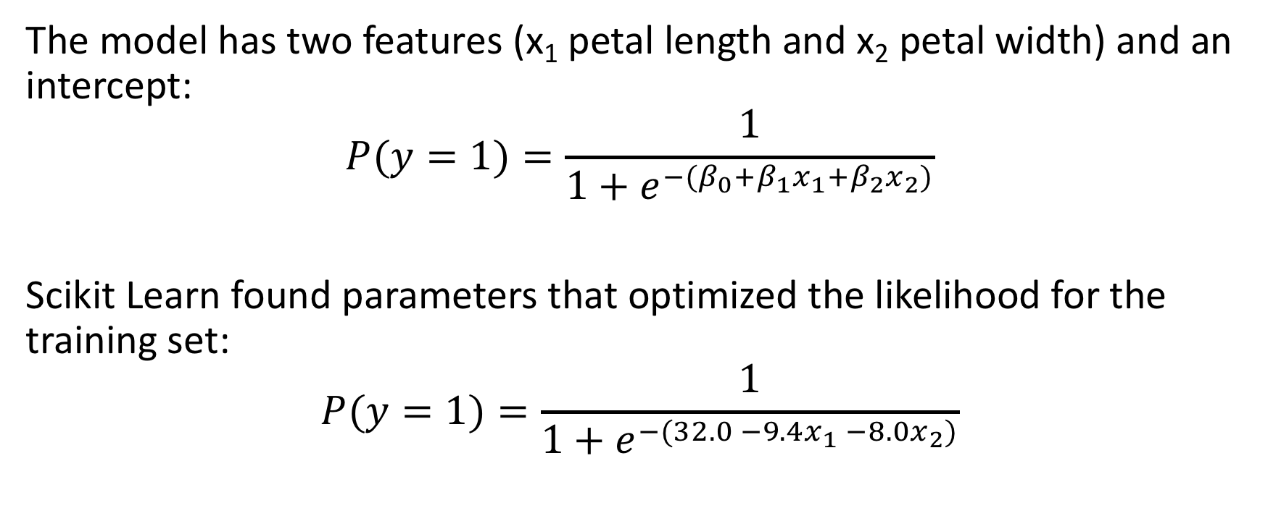
Fitted Model
The model has two features (x₁ petal length and x₂ petal width) and an intercept:
$$P(y=1)=\frac{1}{1+e^{−(β_{0}+β_{1}x_{1}+β_{2}x_{2})}}$$
Scikit Learn found parameters that optimized the likelihood for the training set:
$$P(y=1)=\frac{1}{1+e^{−(32.0 −9.4x_{1} −8.0x_{2})}}$$

Slide 16
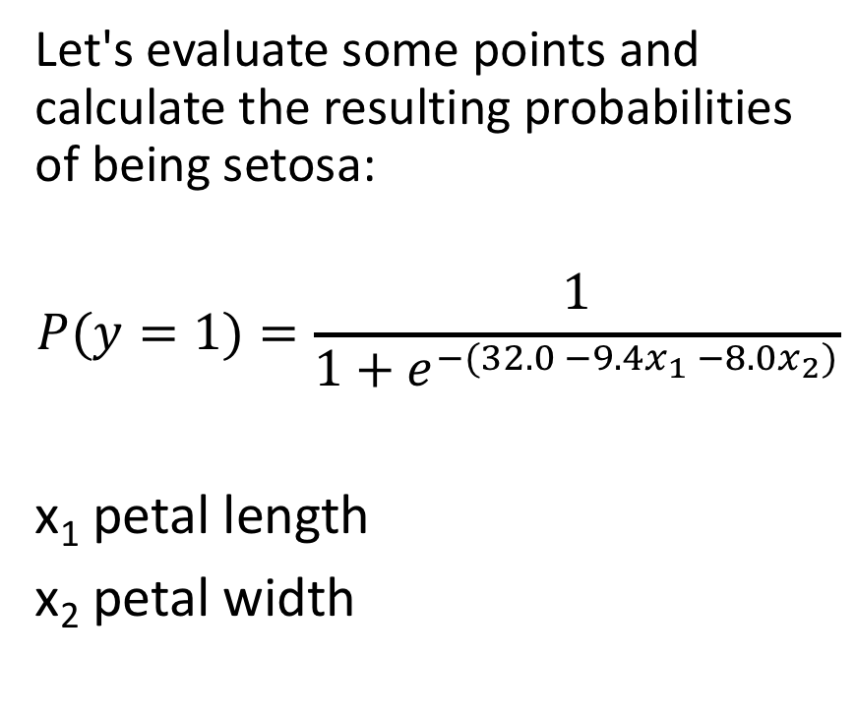
Model Interpretation
Let's evaluate some points and calculate the resulting probabilities of being setosa:
$$P(y=1)=\frac{1}{1+e^{−(32.0 −9.4x_{1} −8.0x_{2})}}$$
x₁ petal length
x₂ petal width

Slide 17
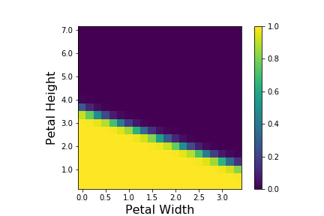
Model Interpretation -- Probabilities

Slide 18
Model Evaluation
Experimental Setup
Training Set
Testing Set
Evaluation metrics compare:
Predicted labels for testing set from model
True labels for the testing set

Slide 19
Definitions
Positive: sample from the positive class
Negative: sample from the negative class
True Positive: positive sample correctly predicted as positive
True Negative: negative sample correctly predicted as negative
False Positive: positive sample incorrectly predicted as negative
False Negative: positive sample incorrectly predicted as positive

Slide 20

Metrics for Evaluating Classification Models
Accuracy – fraction of correct predictions over total samples $Accuracy= \frac{tp+tn}{p+n}$

Slide 21
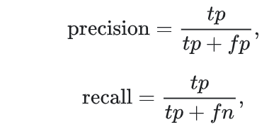
Recall and Precision
Recall – fraction of positive samples that have been correctly predicted
Precision -- fraction of positive predictions that are correct

Slide 22
Confusion Matrix
Matrix of counts of sample true classes and predicted classes
Class exercise: Calculate the following metrics using the confusion matrix:
Accuracy
Precision
Recall
 |  | True
 |  | Positive | Negative
Predicted | Positive | 53 | 90
 | Negative | 10 | 47

Slide 23
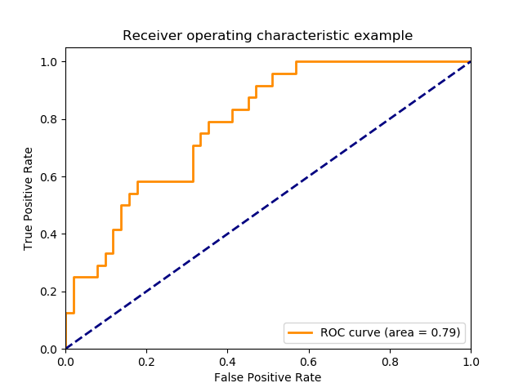
Receiver-Operator Characteristics (ROC) Curve
ROC curves tell us evaluate the trade off between true positive rate (sensitivity) and false positive rate (specificity)
Good classifiers have lines near the upper left
A random classifier produces a diagonal line
ROC curves can help us choose a threshold other the default 0.5

Slide 24
Scikit Learn
Scikit Learn provides a metrics module: acc = metrics.accuracy_score(true_labels, pred_labels)
prec = metrics.precision_score(true_labels, pred_labels)
recall = metrics.recall_score(true_labels, pred_labels)
cm = metrics.confusion_matrix(true_labels, pred_labels)
tpr, fpr, thresholds = metrics.roc_curve(true_labels, pred_prob[:, 1])

Slide 25
Logistic Regression with Multiple Classes
One vs all scheme
Build a model for each class predicting whether a sample is in that class or not
Whichever model predicts the highest probability for its class is used to make the categorical prediction
Done for us by Scikit-learn when we pass a vector of labels with more than 2 values
Multinomial
Extension of Logistic Regression to multiple classes
We won't use this

Slide 26
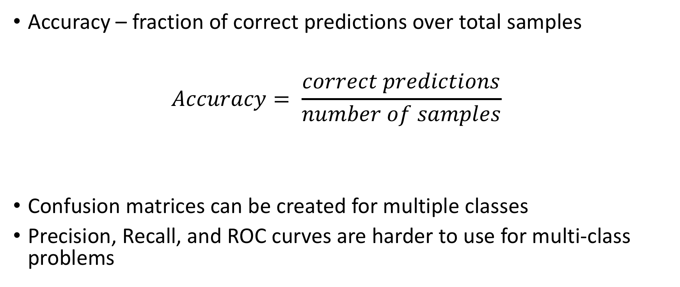
Evaluating Multi-Class Predictions
Accuracy – fraction of correct predictions over total samples $Accuracy= \frac{correct predictions}{number of samples}$
Confusion matrices can be created for multiple classes
Precision, Recall, and ROC curves are harder to use for multi-class problems

